Slide 1

[01]
flightPlanner: Flight Routing Engine
A zero-dependency command-line application for optimal global flight path calculation using custom graph structures and C++17.
Project Proposal
Saeed Ahmed Mahin
BSSE 1703
Institute of Information Technology

Slide 2

[02]
Project Objectives
01.
Large-Scale Graph Construction
03.
Concurrency & Optimization
Represent a massive flight network of 10,000+ airports and 200,000+ flights using an optimized adjacency list in standard C++.
Simulate and optimize for multiple concurrent users searching for flights simultaneously, ensuring thread-safe data access.
02.
Advanced Algorithmic Routing
PERFORMANCE TARGET
Implement and compare Dijkstra, Bi-directional Dijkstra, A*, and Yen's Algorithm for multi-criteria pathfinding.
Achieve sub-millisecond query latency for complex itineraries while maintaining a minimal memory footprint through contiguous allocation.

Slide 3

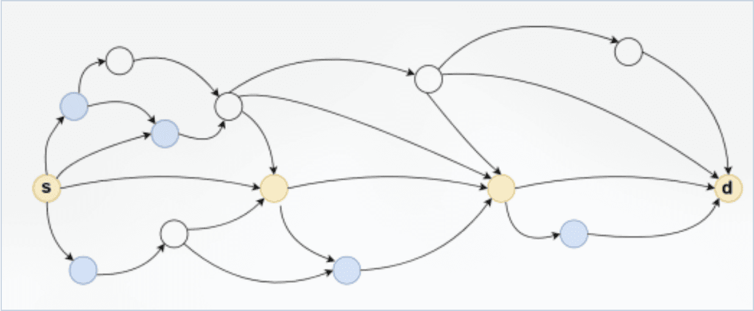
[03]
Core Features & Functionality
Multi-Criteria Route Search
Support for "Cheapest" (price minimization) and "Fastest" (total elapsed time) routing modes using weighted graph edges.
Dynamic Connection Validation
On-the-fly calculation of layover feasibility, preventing invalid connections based on real-world time constraints.
Terminal-Based Interface
A clean, text-based CLI for querying routes, viewing itineraries, and managing system parameters.
Figure 1: Abstract representation of the directed flight network structure.
$ flightPlanner --from DAC --to JFK --mode fastest
> Calculating optimal route...
> Found: DAC -> DXB -> JFK (18h 45m) (690 USD)

Slide 4

[04]
Benchmark & Performance Evaluation
ALGORITHM / OPERATION
TIME COMPLEXITY
SPACE COMPLEXITY
Dijkstra / Bi-Dijkstra / A*
O(E log V)
O(V)
Yen's Algorithm (K-Paths)
O(K · V(E + V log V))
O(K · E + V)
Concurrent Query Handling
O(N / Threads)
O(V + E) Shared
Algorithmic Trade-offs
Optimization Focus
While A* and Bi-Dijkstra optimize for single-query speed, Yen's Algorithm provides critical redundancy for flight planning at a higher computational cost.
The project focuses on thread-safe read-only graph access, allowing multiple users to query the 200,000+ flight network simultaneously without data contention.

Slide 5

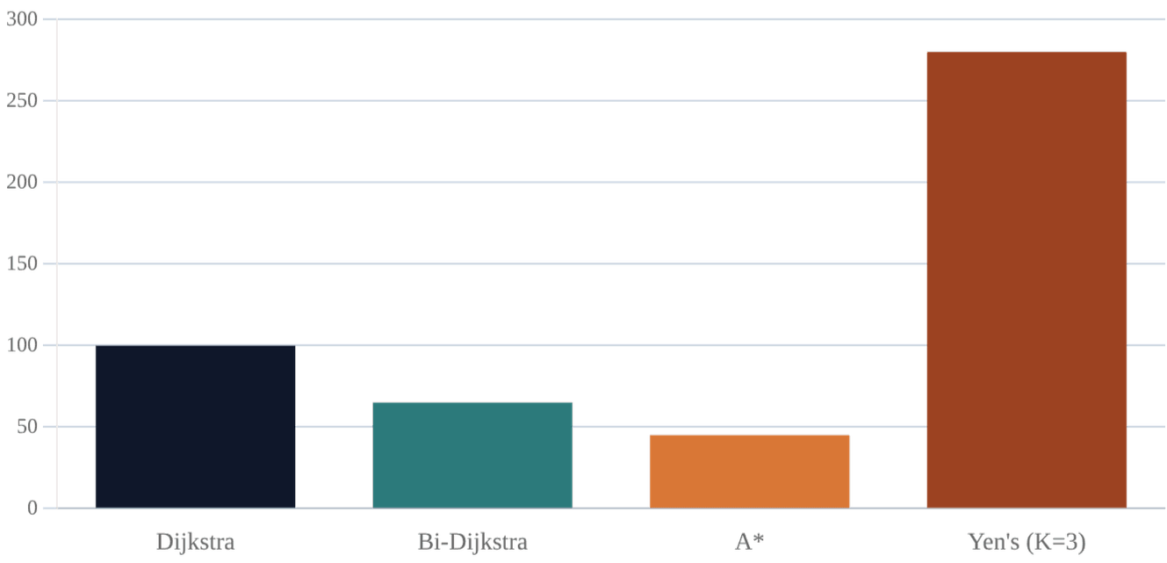
[05]
Algorithmic Performance Comparison
Search Space Pruning
A* and Bi-directional Dijkstra significantly reduce the number of visited nodes by using heuristics and meeting in the middle, respectively.
K-Shortest Paths
Yen's Algorithm is used for finding alternative routes but carries a higher computational cost ($O(K \cdot V \cdot (E + V \log V))$).
Baseline
Standard Dijkstra serves as the robust baseline for single-source shortest path calculation.
Note: Values represent relative expected execution time based on algorithmic complexity and search space pruning.

Slide 6

[06]
Project Timeline & Prerequisites
SEPTEMBER
Data Ingestion & Parsing
Implementation of the C++ CSV parser and construction of the contiguous memory graph structure from raw flight data.
Prerequisite: Python, NumPy, CMake
OCT — NOV
Algorithms & Optimization
Development of Dijkstra, A*, and Yen's algorithms. Optimization for concurrent user queries and search space pruning.
Prerequisite: Algorithm Course Fundamentals
DECEMBER
Visualization & Findings
Performance benchmarking and final visualization of routing efficiency and algorithmic trade-offs.
Prerequisite: Python, Seaborn

Slide 7
[07]
Technology Stack & Constraints
CORE APPLICATION (C++17)
Standard Library
Zero External Dependencies
Zero-Dependency Constraint
CMake
Build System
To demonstrate mastery of memory management and data structures, the engine will not use external libraries (Boost, SQLite, etc.).
All graph structures and pathfinding algorithms are implemented from scratch.
DATA & VISUALIZATION PIPELINE
Python / NumPy
Data Preprocessing
Seaborn
Performance Graphing

